Slide 1
PT. ALPHA SIGMA DIGITAL
“Your Digital Ways”

Slide 2

PT. ALPHA SIGMA DIGITAL
“LET'S BUILD THE INFRASTRUCTURE AND DIGITAL ASSETS FOR YOUR INSTITUTION, COMPANY, ORGANIZATION, OR FOUNDATION NOW.”
PT. ALPHA SIGMA DIGITAL
www.alphasigma.com

Slide 3
About us
PT. ALPHA SIGMA DIGITAL
We are a Start-Up company specializing in the development of infrastructure and digital assets for small, medium, and large-scale Institutions, Companies, Organizations, and Foundations seeking efficiency and effectiveness for their operations. Throughout our journey, we have assisted several organizations through consultation and development, including integrated information systems, mobile applications, data analysis, digital marketing, and cybersecurity. The following are the development focuses of PT. Alpha Sigma Digital :
Low Code Information System
Website Services
Mobile Application (Apps) Development
Digital Branding & UI/UX Consulting
Digital Marketing
Data Science & Analysis
Cyber Security
www.alphasigmadigital.com
PT. ALPHA SIGMA IGITAL
www.alphasigma.com
PT. ALPHA SIGMA DIGITAL

Slide 4
LOW CODE
INFORMATION SYSTEM
Nowadays, data has become crucial and the need for quick presentation is more pressing than ever. Imagine being a company leader dealing with thousands of transactions per day; you might not remember the day or time of the highest transaction volume. Or perhaps you want to know who your earliest computer and furniture suppliers were? What is the value of your organization's assets, or how much depreciation has occurred?
In such scenarios, you would typically turn to your accounting department. However, you and your accountants would spend a whole day, maybe even working overtime, searching for files, extracting figures, and analyzing data. With a Low Code Platform-based Information System, you only need to click once, and the data you need can be presented instantly.
We aim to kickstart the digitization of your Institution, Company, Organization, or Foundation, beginning with data availability. The core of the digitization process is the Database Management System (DBMS). We are enthusiastic about encouraging you to use this advanced platform to enhance the efficiency and effectiveness of your organization, all while ensuring user-friendly functionality.
PT. ALPHA SIGMA DIGITAL
www.alphasigma.com

Slide 5
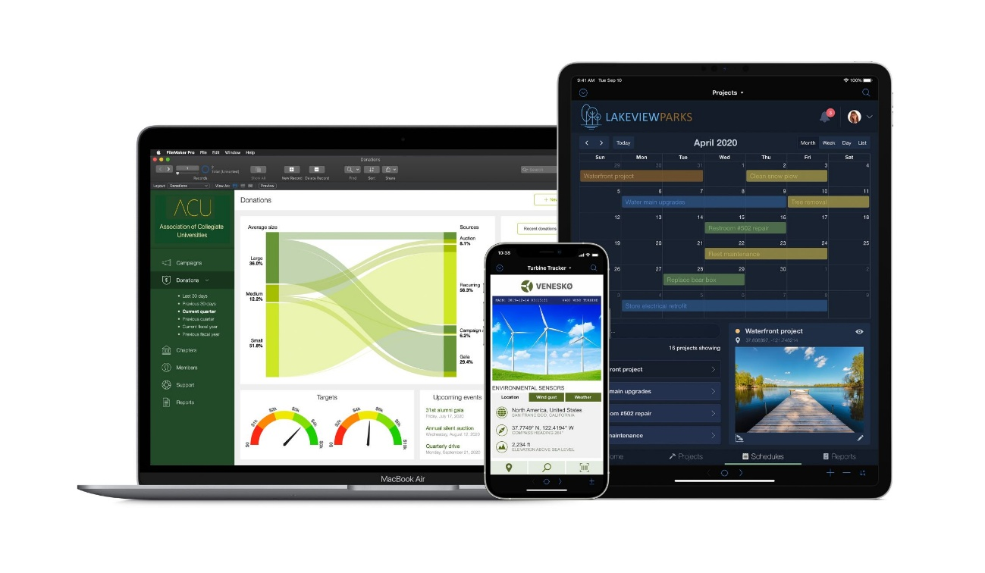
ADVANTAGES
LOW CODE INFORMATION SYSTEM
There are several advantages to the Low Code-based Information System that we will develop for your Institution, Company, Organization, and Foundation, including:
Ease for Use
Suitable for Small, Medium, or Large Businesses
Robust Platform
Flexibility and Personalization
Control over Data Analysis and Presentation
Integrated Communication across Operating Systems
Integration with Other Software
Data Security.
Diverse Platform Components
PT. ALPHA SIGMA DIGITAL
www.alphasigma.com

Slide 6
CLARIS
FILEMAKER

Slide 7

CLARIS
FILEMAKER
Claris FileMaker is a relational database management system (RDBMS) that allows users to create custom applications for managing data. It provides a platform for designing, developing, and deploying database solutions without the need for extensive programming skills. Claris FileMaker is a versatile and user-friendly platform for creating custom applications tailored to the unique needs of businesses. Known for its rapid development capabilities, the platform features a drag-and-drop interface that allows users to design and deploy applications without extensive coding. It supports cross-platform compatibility, enabling applications to run seamlessly on Windows, macOS, iOS, and the web. Claris FileMaker's strength lies in its customization options, allowing businesses to create bespoke solutions that align with their specific workflows.
The platform's integration capabilities facilitate connections with external databases and services, promoting streamlined processes. With robust security features, cloud deployment options, and scalability, Claris FileMaker is a cost-effective solution for businesses seeking efficient, flexible, and accessible custom application development. The active community and support resources further contribute to its appeal as a comprehensive tool for businesses of various sizes.
www.alphasigmadigital.com
PT. ALPHA SIGMA IGITAL
www.alphasigma.com
PT. ALPHA SIGMA DIGITAL

Slide 8
CLARIS
FILE MAKER
Claris FileMaker is a relational database management system (RDBMS) that allows users to create custom applications for managing data. It provides a platform for designing, developing, and deploying database solutions without the need for extensive programming skills. Claris FileMaker is a versatile and user-friendly platform for creating custom applications tailored to the unique needs of businesses. Known for its rapid development capabilities, the platform features a drag-and-drop interface that allows users to design and deploy applications without extensive coding. It supports cross-platform compatibility, enabling applications to run seamlessly on Windows, macOS, iOS, and the web.
Claris FileMaker's strength lies in its customization options, allowing businesses to create bespoke solutions that align with their specific workflows. The platform's integration capabilities facilitate connections with external databases and services, promoting streamlined processes. With robust security features, cloud deployment options, and scalability, Claris FileMaker is a cost-effective solution for businesses seeking efficient, flexible, and accessible custom application development. The active community and support resources further contribute to its appeal as a comprehensive tool for businesses of various sizes.
www.alphasigmadigital.com
PT. ALPHA SIGMA IGITAL
www.alphasigma.com
PT. ALPHA SIGMA DIGITAL

Slide 9
WHY
CLARIS FILEMAKER?
There are several reasons why Claris FileMaker is commonly used for custom apps in a business context:
User-Friendly Interface
Rapid Development
Customization
Cross-Platform Compatibility
Integration Capabilities
Scalability
Cloud Deployment
Security Features
Cost-Effective Solution
Community and Support
www.alphasigmadigital.com
PT. ALPHA SIGMA IGITAL
www.alphasigma.com
PT. ALPHA SIGMA DIGITAL

Slide 10
PROBLEM SOLVING
ENGINE
Claris can be considered a problem-solving engine for several reasons:
Rapid Application Development
Flexibility and Customization
Cross-Platform Compatibility
Integration Capabilities
Scalability
Cloud Deployment
Community Support and Resources
Security Measures
In summary, Claris serves as a problem-solving engine by offering a combination of rapid application development, flexibility, cross-platform compatibility, integration capabilities, scalability, cloud deployment options, and a supportive community. These features collectively empower businesses to address diverse challenges efficiently and effectively through custom-built solutions.
www.alphasigmadigital.com
PT. ALPHA SIGMA IGITAL
www.alphasigma.com
PT. ALPHA SIGMA DIGITAL

Slide 11
“Don't need to think innovatively and rush in time
because Claris is the one doing the thinking.
We just need to focus on developing”
www.alphasigmadigital.com
PT. ALPHA SIGMA IGITAL
www.alphasigma.com
PT. ALPHA SIGMA DIGITAL

Slide 12
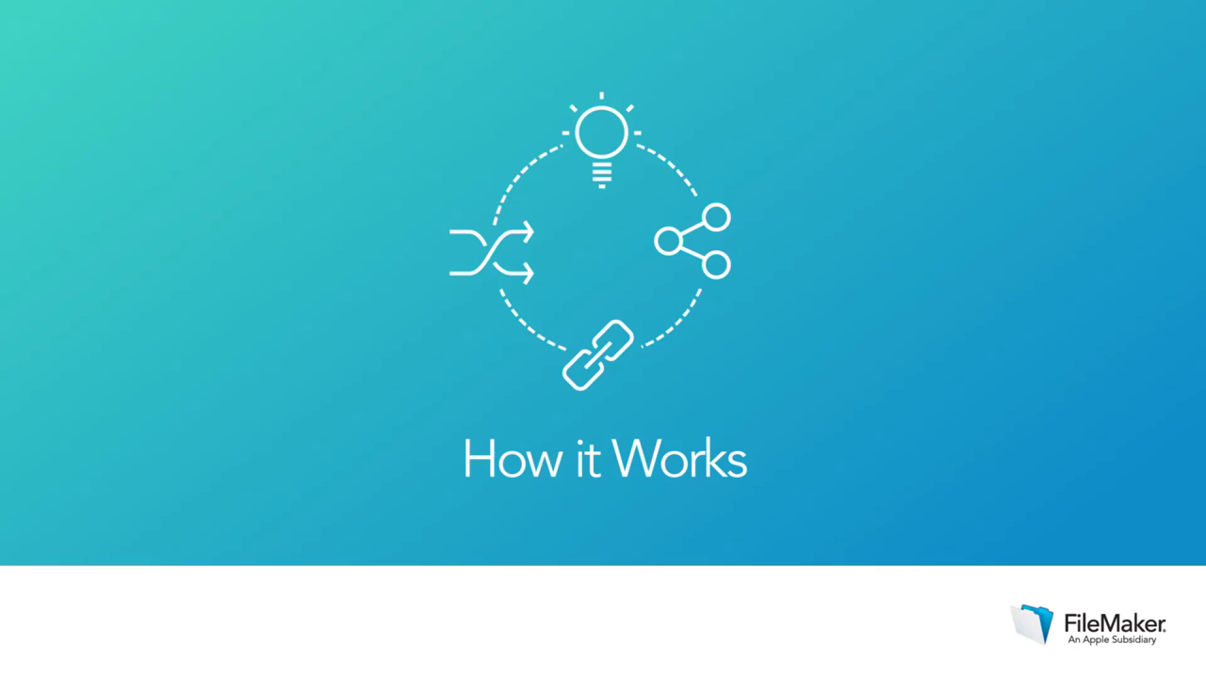
CLARIS
PLATFORM
www.alphasigmadigital.com
PT. ALPHA SIGMA IGITAL
www.alphasigma.com
PT. ALPHA SIGMA DIGITAL

Slide 13
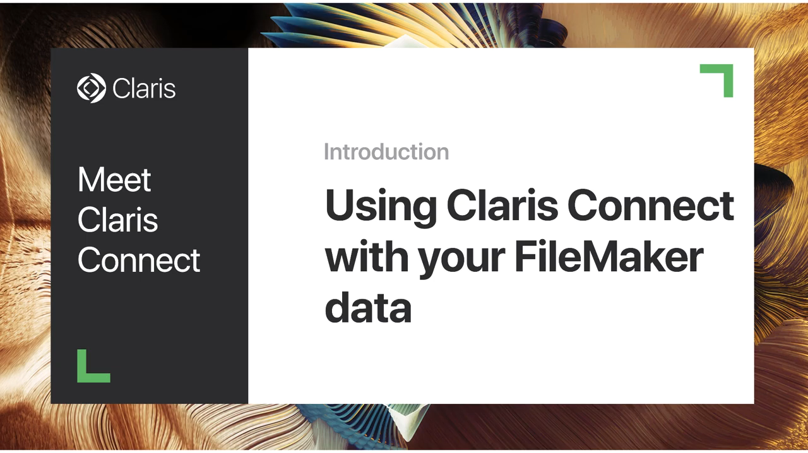
CLARIS
CONNECT
www.alphasigmadigital.com
PT. ALPHA SIGMA IGITAL
www.alphasigma.com
PT. ALPHA SIGMA DIGITAL

Slide 14
UEA
PARTNER
Claris FileMaker establishes strategic partnerships in the United Arab Emirates to enhance its presence and support within the region. These partnerships involve collaborations with reputable companies and organizations in the UAE that align with Claris FileMaker's mission to provide innovative and tailored solutions. Through these partnerships, Claris aims to extend its reach, deliver high-quality services, and promote the adoption of its platform for custom application development. By fostering strong relationships with partners in the UAE, Claris FileMaker seeks to meet the diverse needs of businesses and organizations in the region, offering them powerful tools for efficient and customized data management solutions
https://kizasolutions.com/
http://sape.co/
www.alphasigmadigital.com
PT. ALPHA SIGMA IGITAL
www.alphasigma.com
PT. ALPHA SIGMA DIGITAL

Slide 15
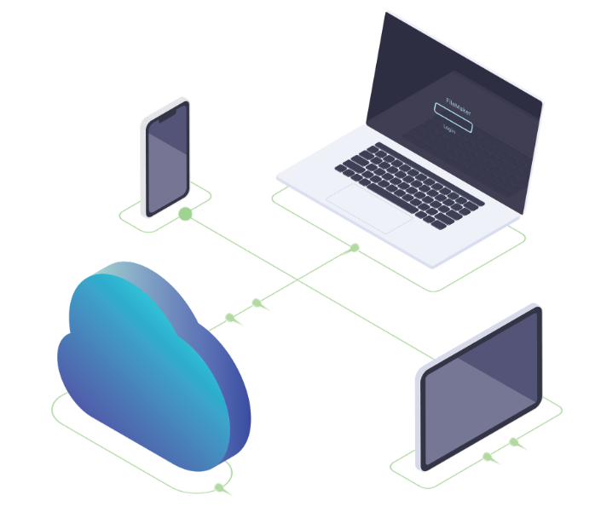
CLARIS FILEMAKER
PRICING
Claris Cloud
Essentials
$21.00/ user/month → 12 months
$20.41/ user/ month → 24months
$20.22/ user/ month → 36months
On Premise
Annual
$16.50/ user/month → 12 months
$15.25/ user/ month → 24months
$14.30/ user/ month → 36months
Claris Cloud
Standard
$43.00/ user/month → 12 months
$39.70/ user/ month → 24months
$37.19/ user/ month → 36months
On Premise
Annual
$594.00/ user → 12 months
$695.00/ user → 24months
$784.00/ user → 36months
www.alphasigmadigital.com
PT. ALPHA SIGMA IGITAL
www.alphasigma.com
PT. ALPHA SIGMA DIGITAL

Slide 16
“We ready to the world”
How about you?

